Slide 1
Group-4 PETORG
Group Member:
1.Tarikuzzaman Tuhin 011192003
2.Farhan Shahriar alvi 011192010
3.Most.sumiya Yeasmin Labannaya 011192001
4.Ariful islam 011192006
5.Mahmudul hassan 011192013

Slide 2
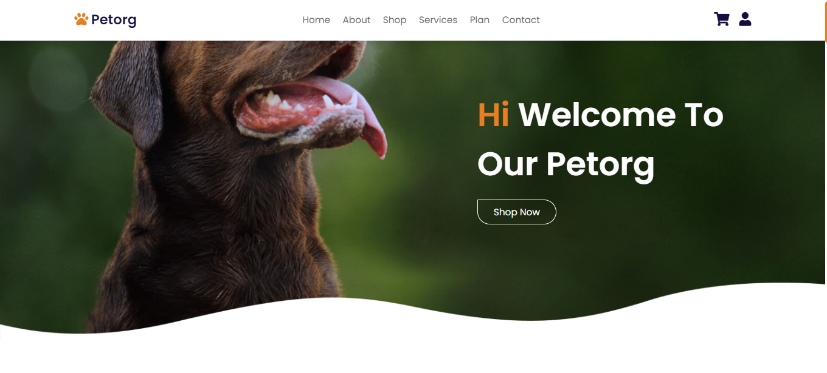
recognition
Makes information easy to discover

Slide 3
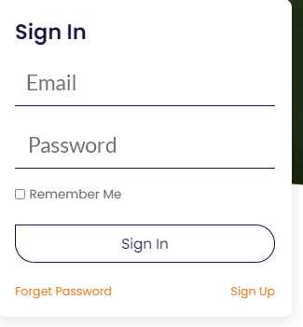
minimalism
Short and meaningful words used where necessary

Slide 4
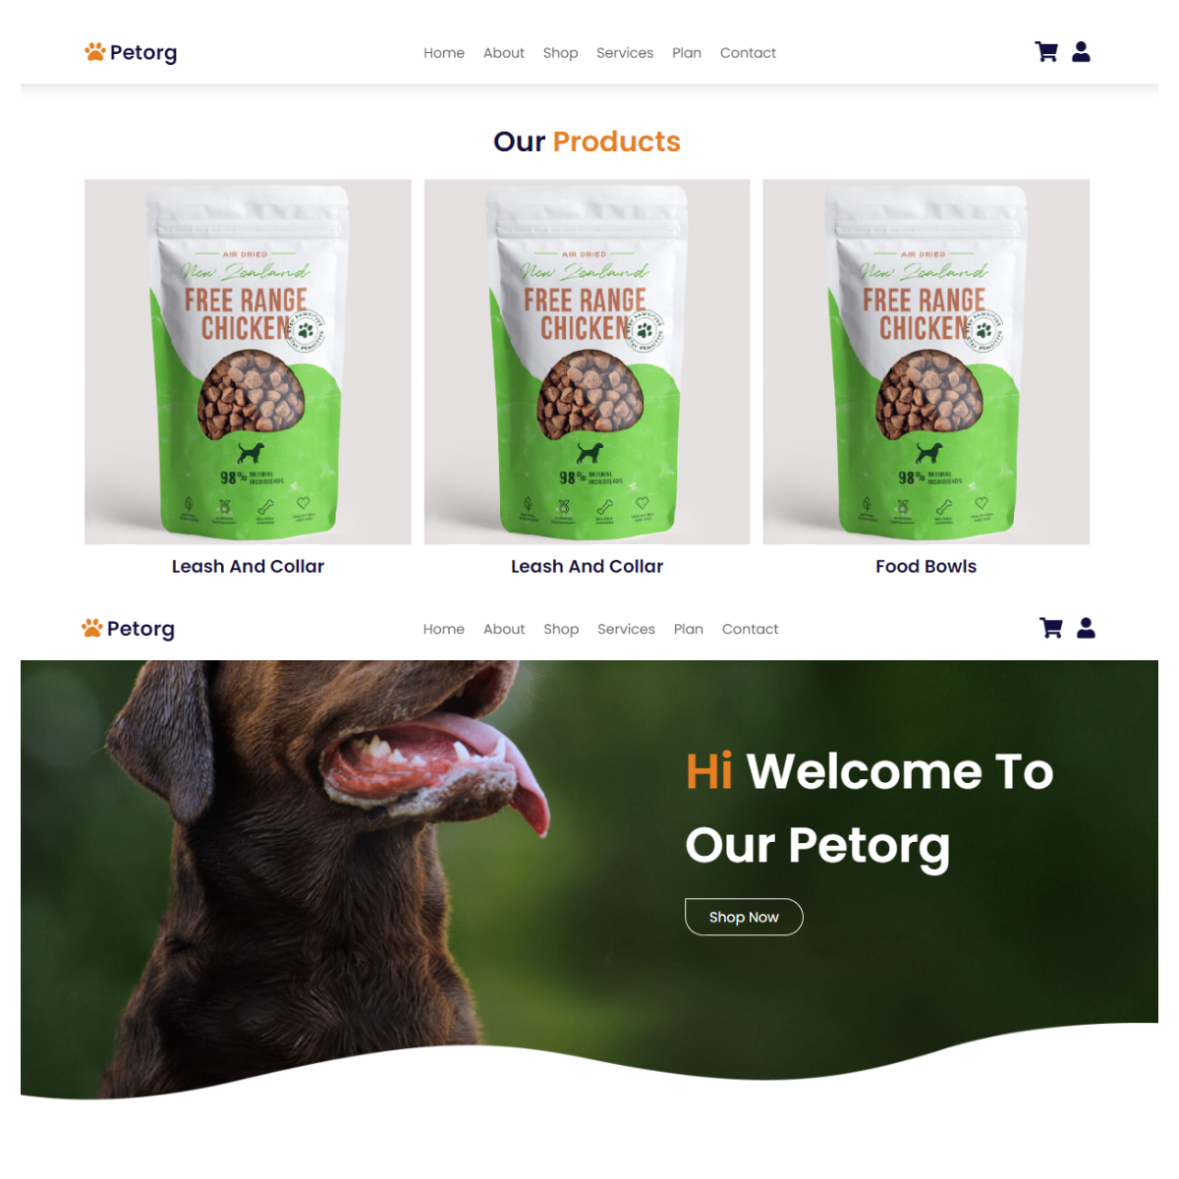
consistency
Some interfaces are consistent throughout the project

Slide 5
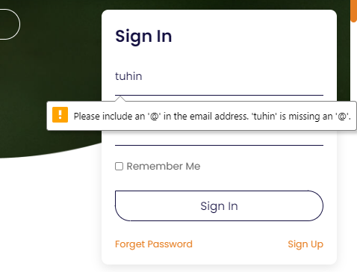
Error prevention
Error message will appear if wrong credentials is provided

Slide 6
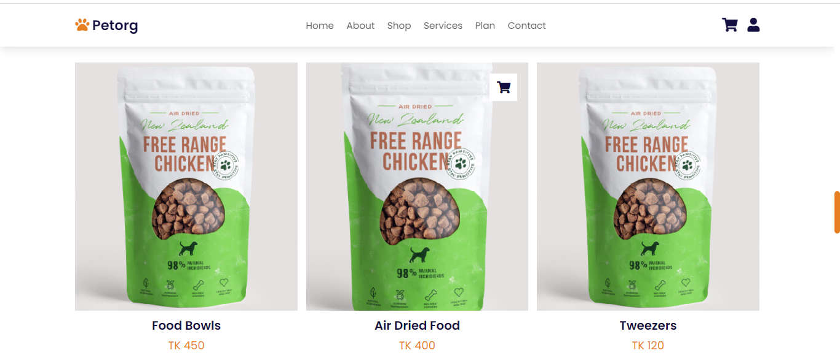
flexibility
Advanced task implemented in an easy way

Slide 7
Thank You

